Slide 1
WebLogic on Kubernetes
Maciej Gruszka
Director Product Management
April 10, 2019
Note: The speaker notes for this slide include detailed instructions on how to customize this Title Slide with your own picture.
Tip! Remember to remove this text box.
Notes:
This is a Title Slide with Picture slide ideal for including a picture with a brief title, subtitle and presenter information.
To customize this slide with your own picture:
Right-click the slide area and choose Format Background from the pop-up menu. From the Fill menu, click Picture and texture fill. Under Insert from: click File. Locate your new picture and click Insert.
To copy the Customized Background from Another Presentation on PC
Click New Slide from the Home tab's Slides group and select Reuse Slides.
Click Browse in the Reuse Slides panel and select Browse Files. Double-click the PowerPoint presentation that contains the background you wish to copy.
Check Keep Source Formatting and click the slide that contains the background you want.
Click the left-hand slide preview to which you wish to apply the new master layout.
Apply New Layout (Important): Right-click any selected slide, point to Layout, and click the slide containing the desired layout from the layout gallery.
Delete any unwanted slides or duplicates.
To copy the Customized Background from Another Presentation on Mac
Click New Slide from the Home tab's Slides group and select Insert Slides from Other Presentation…
Navigate to the PowerPoint presentation file that contains the background you wish to copy. Double-click or press Insert. This prompts the Slide Finder dialogue box.
Make sure Keep design of original slides is unchecked and click the slide(s) that contains the background you want. Hold Shift key to select multiple slides.
Click the left-hand slide preview to which you wish to apply the new master layout.
Apply New Layout (Important): Click Layout from the Home tab's Slides group, and click the slide containing the desired layout from the layout gallery.
Delete any unwanted slides or duplicates.

Slide 2
Notes:
This is a Safe Harbor Front slide, one of two Safe Harbor Statement slides included in this template.
One of the Safe Harbor slides must be used if your presentation covers material affected by Oracle’s Revenue Recognition Policy
To learn more about this policy, e-mail: Revrec-americasiebc_us@oracle.com
For internal communication, Safe Harbor Statements are not required. However, there is an applicable disclaimer (Exhibit E) that should be used, found in the Oracle Revenue Recognition Policy for Future Product Communications. Copy and paste this link into a web browser, to find out more information.
http://my.oracle.com/site/fin/gfo/GlobalProcesses/cnt452504.pdf
For all external communications such as press release, roadmaps, PowerPoint presentations, Safe Harbor Statements are required. You can refer to the link mentioned above to find out additional information/disclaimers required depending on your audience.

Slide 3


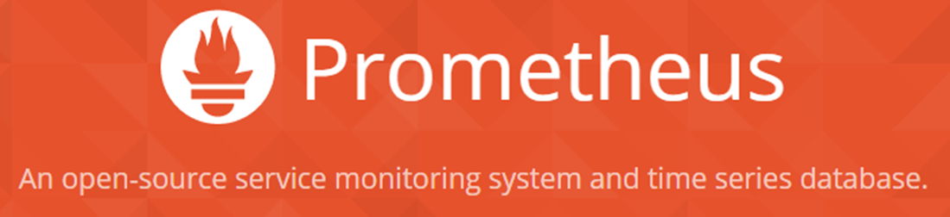






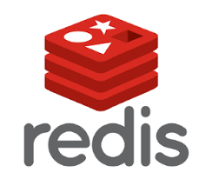


WebLogic, Coherence and Cloud Native Trends
Industry trends
Microservices, serverless
Private and public clouds
Containers, orchestration frameworks
WebLogic, Coherence customer demand
Leverage cloud neutral infrastructure
Integrate with new tools and services
Evolve WebLogic, Coherence for these environments
Blockchain
WebLogic
Coherence
WebLogic
Notes:
Why move WLS to Kubernetes?
Portability to private and public clouds
Ease of Use
Provide new ways to deploy, monitor, diagnose WLS by integrating with new tools and services
Evolve WebLogic to run in a Kubernetes platform/cloud native platform

Slide 4

Migrating to Kubernetes in the Cloud
Migrate to Kubernetes on premise
Tools for migration and lifecycle management
Full WebLogic compatibility
Migrate to Kubernetes on OCI
Leverage OCI, Container Engine for Kubernetes
Enterprise availability, security, scaling, low-cost
WebLogic, Kubernetes tool compatibility
Leverage new App Dev capabilities on OCI
Kubernetes on OCI
Blockchain
Operator
WebLogic
WebLogic
WebLogic
Migrate
Operator
Migrate
WebLogic
WebLogic
WebLogic
WebLogic
WebLogic
WebLogic
Kubernetes on Premise
Physical & VMs On Premise
Notes:
Incremental steps into the cloud. We’re creating “waypoints” on the bridge to the cloud, so each step feels less onerous

Slide 5
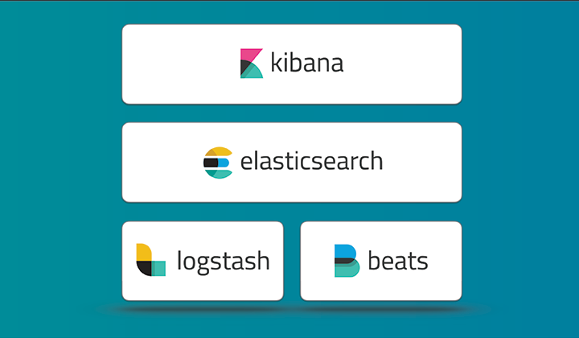
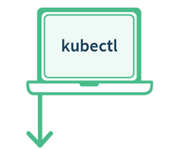
Building Blocks for WebLogic Kubernetes Support
WebLogic Docker certification
Docker images, Dockerfiles, examples
WebLogic Kubernetes certification
How-to, best practices
Value add integration
Management: Operator
Monitoring: Exporter for Prometheus
Migration: Deploy tooling
Logging: Exporter for Elastic Stack
Image: Tool management
Operator
Kubernetes
WebLogic
WebLogic
WebLogic
Notes:
We also have developed Open Sourced utilities like the Operator – to help deployment and management of the WebLogic domain and the Kubernetes resources on behalf of the WebLogic domain
Monitoring Exporter – to export the WebLogic runtime metrics that can be consumed by tools like Prometheus and Grafana
Deploy Tooling : to help take WebLogic configuration from on premises and move them to Containers/Kubernetes environments

Slide 6
Certified product versions
Product | Version
WebLogic (including FMW Infrastructure images) | 12.2.1.3 with patches p29135930 & p27117282
Kubernetes | 1.10.11+, 1.11.5+, 1.12.3+, 1.13.4+
Docker | 18.9.01ce, 18.03.01ce (OL) 1.12.6 and 1.13.1(Red Hat)
Kernels | Oracle Linux 17.5 & Red Hat Enterprise Linux 7 (UL3+)
Flannel | v0.9.0-1-amd64
Helm | 2.8.2+

Slide 7
WebLogic Monitoring Exporter
Monitoring Exporter enables Prometheus monitoring of WebLogic
Standard monitoring tools can be used for monitoring WebLogic
Grafana Dashboards used for visualization
Prometheus auto-scaling of WebLogic cluster
Prometheus and Grafana example GitHub Sample
Operator
Scale
WLS
Kubernetes
Kubernetes
Monitor
WebLogic
WebLogic
WebLogic
MS
MS

Slide 8
WebLogic Deploy Tooling
Introspect domains
WebLogic 10.3.6, 12.1.3, 12.2.1.X
Create a model (yaml) of the domain
Migrate existing domains and applications Upgrade (if required) to 12.2.1.X
Customize and Validate configuration to meet Kubernetes requirements
Create domains in Docker image GitHub Sample
WebLogic Deploy Tooling
Domain Model
WebLogic
WebLogic
WebLogic

Slide 9
WebLogic Logging Exporter
Logging Exporter enables exporting WebLogic server logs to the Elastic Stack
Store logs in the Elastic Stack
Search and analyze logs in Elastichsearch
Display logs in dashboards in Kibana
Integrate with FluentD (future)
GitHub weblogic-logging-exporter
Operator
Kubernetes
Kubernetes
WebLogic
WebLogic
WebLogic
MS
MS

Slide 10




Patching WebLogic Image with WebLogic Image Tool
Repository
Future
My Oracle Support
Operator
Image
Download
p29135930 & p27117282
WLS Domain Image
Kubernetes
WLS Image Tool
WLS 12.2.1.3 Binary Image
Use cases
Apply patches p29135930 & p27117282
Build image from scratch
WLS 12.2.1.3
JDK 8_u201
OL 7.5
p29135930 & p27117282
WebLogioc 12.2.1.3 binaries
Server JRE
Build image from already existing image
Oracle Linux
Apply patches p29135930 & p27117282
WLS 12.2.1.3 patched Binary Image
WLS 12.2.1.3 Binary Image from Repository
p29135930 & p27117282
WLS 12.2.1.3 Binary Image
Build domain image based on WLS 12.2.1.3
WLS 12.2.1.3
p29135930 & p27117282
Domain yaml model & Application binaries
With WDT build a domain image with application
WLS Domain Image Patched
WLS 12.2.1.3 patched Binary Image

Slide 11



Why build the WebLogic Kubernetes Operator?
The Oracle WebLogic Server Kubernetes Operator contains a set of useful built-in knowledge about how to perform various lifecycle operations on a domain correctly.
The Operator using a common set of Kubernetes APIs, provides advanced user experience, automating operations such as:
provisioning
life cycle management
updates
scaling
Security
The operator is not an administrator of the WebLogic domain. The operator has only limited interest in the domain configuration, with its main concern being the high-level topology of the domain.
Operator
Kubernetes
Orchestrate WebLogic
Manage
Pods
WLS Cluster
POD 1
POD 2
POD 3
POD 4
POD 5
POD 6
AS
MS
MS
MS
MS
MS
Kubernetes Cluster
Notes:
Operator is an application-specific controller that extends Kubernetes to create, configure, and manage instances of complex applications. The WebLogic Kubernetes Operator follows the standard Kubernetes Operator pattern,
Some of the things that the Operator does to simplify management and operations on the WebLogic domain and deployments
Create RBAC roles to manage Kubernetes resources on behalf of the WebLogic domain. Authorization to start/stop/.restart/create new domain.
Invokes the right Kubernetes APIs to start or stop servers, domains, clusters
the WebLogic Diagnostic framework Auto-scale setting rules in when the rule is met the Operator will invoke K8S API to scale the WebLogic cluster
When there is a new patched WebLogic image or a Application update initiate a rolling restart of the WebLogic domain

Slide 12
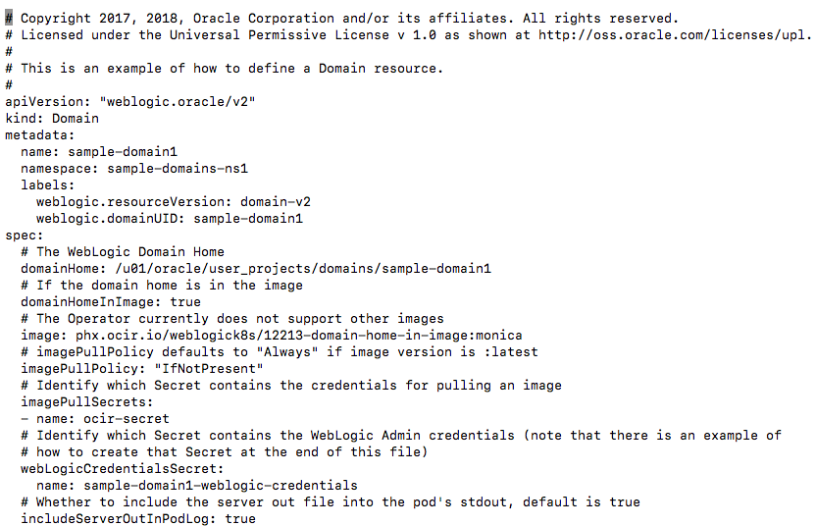
Kubernetes Custom Resources
domain.yaml
A custom resource (CR) allows you to define your own object that extends the Kubernetes API.
A custom resource definition (CRD) file defines your own object kinds and lets the Kubernetes API server to begin serving the specified custom resource.
The CRD is defined in a yaml file that represents the CR.
To create the custom resource
kubectl apply –f domain.yaml

Slide 13
WebLogic Domain Custom Resource
We create a Kubernetes Resource Object for the WebLogic domain. This is a data structure representation of the WebLogic domain in Kubernetes.
Domain Custom Resource allows you to declare or specify the desired state of the resource.
Example I want 3 replicas of managed servers running in the WLS cluster.
The WebLogic Kubernetes Operator is a controller that is always looking at the Domain Custom Resource and tries to match the actual state to this desired state.
Example: Change replicas from 3 to 4, the Operator will start a new pod to match number of replicas.
Domain Custom Resource
Meta Data: Name of Resource, Namespace, Labels, …
Admin Server: Node Ports to expose, Volumes, …
Cluster: Number of Replicas (Managed Servers), …
Domain: Image to base the Domain containers, Domain in PV or in Image, K8S secrets, Logs to pod
Managed Servers: non-clustered MS
Server Pod: Java Options, Start Policy (Lifecycle control)
Events:

Slide 14
WebLogic Kubernetes Operator Simplifies management of the WebLogic domain
Create RBAC roles to manage K8S resources
Create (new) domain
Monitor instances (liveliness and readiness)
Start/stop instances
Scale up/down domain
Auto-scale domain
Rolling Restart of patched domains and updated applications
Operator
Kubernetes
Orchestrate WebLogic
Manage
Pods
WLS Cluster
POD 1
POD 2
POD 3
POD 4
POD 5
POD 6
AS
MS
MS
MS
MS
MS
Kubernetes Cluster
Notes:
Operator is an application-specific controller that extends Kubernetes to create, configure, and manage instances of complex applications. The WebLogic Kubernetes Operator follows the standard Kubernetes Operator pattern,
Some of the things that the Operator does to simplify management and operations on the WebLogic domain and deployments
Create RBAC roles to manage Kubernetes resources on behalf of the WebLogic domain. Authorization to start/stop/.restart/create new domain.
Invokes the right Kubernetes APIs to start or stop servers, domains, clusters
the WebLogic Diagnostic framework Auto-scale setting rules in when the rule is met the Operator will invoke K8S API to scale the WebLogic cluster
When there is a new patched WebLogic image or a Application update initiate a rolling restart of the WebLogic domain

Slide 15
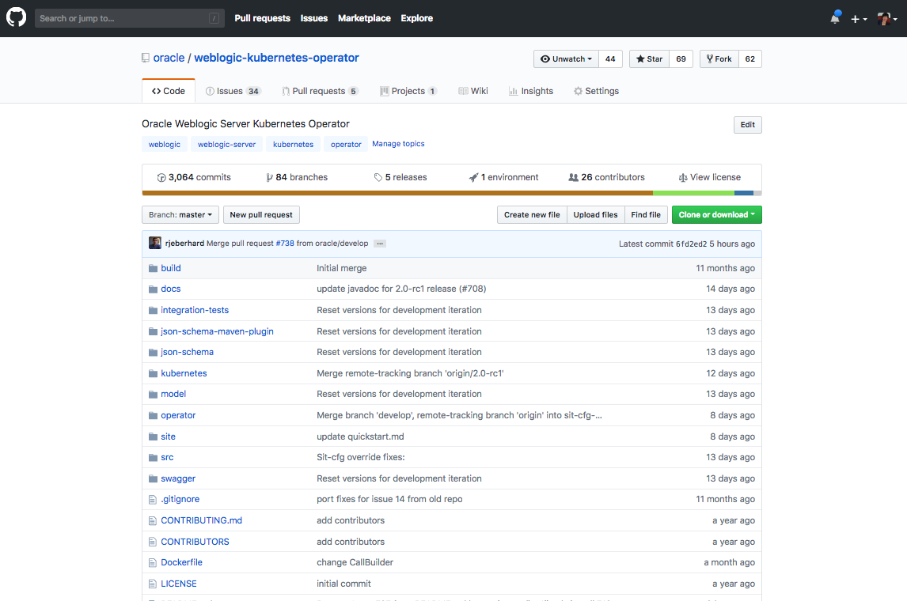
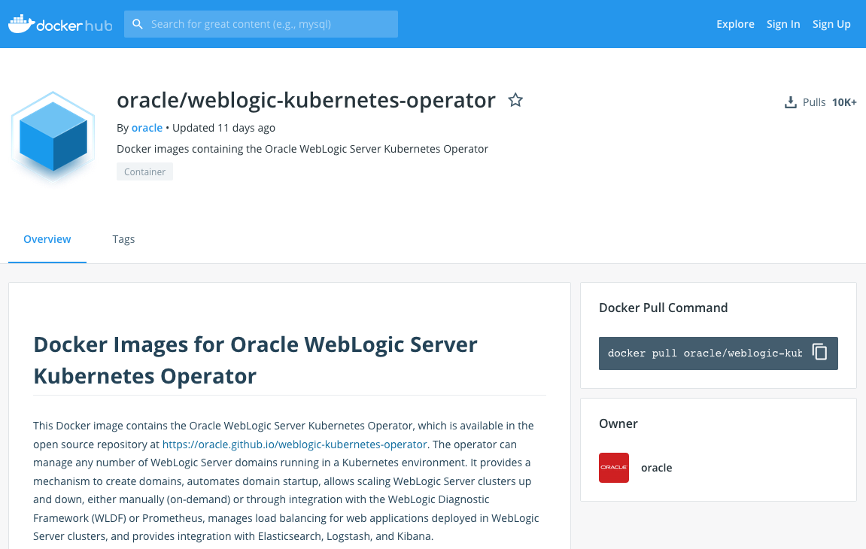
Operator Image
GitHub WebLogic Kubernetes Operator
DockerHub Oracle WebLogic Operator

Slide 16
WebLogic Domain in Kubernetes Operator v 2.0
Domain Home in Image
Customer Tenancy
Repository
WLS Domain Image
Operator
Image
Kubernetes
Kubernetes Cluster
Kubernetes

Slide 17
WebLogic Domain in Kubernetes Operator v 2.0
Customer Tenancy
Repository
WLS Domain Image
Operator
Image
Kubernetes
Kubernetes Cluster
Secrets
Kubernetes

Slide 18

WebLogic Domain in Kubernetes Operator v 2.0
Customer Tenancy
Repository
WLS Domain Image
Operator
Image
Kubernetes
Kubernetes Cluster
Secrets
Operator
Kubernetes

Slide 19
WebLogic Domain in Kubernetes Operator v 2.0
Customer Tenancy
Repository
WLS Domain Image
Operator
Image
Kubernetes
Kubernetes Cluster
Secrets
Operator
Kubernetes

Slide 20
WebLogic Domain in Kubernetes Operator v 2.0
Customer Tenancy
Repository
WLS Domain Image
Operator
Image
Kubernetes
Kubernetes Cluster
Secrets
Operator
Kubernetes

Slide 21
WebLogic Domain in Kubernetes Operator v 2.0
Customer Tenancy
Repository
WLS Domain Image
Operator
Image
Kubernetes
Kubernetes Cluster
Secrets
Operator
Install Domain inputs (yaml)
Kubernetes

Slide 22
WebLogic Domain in Kubernetes Operator v 2.0
Customer Tenancy
Repository
WLS Domain Image
Operator
Image
Kubernetes
Domain
Kubernetes Cluster
Secrets
Operator
Install Domain inputs (yaml)
Kubectl apply …
Kubernetes

Slide 23
WebLogic Domain in Kubernetes Operator v 2.0
Customer Tenancy
Repository
WLS Domain Image
Operator
Image
Kubernetes
Domain
Kubernetes Cluster
Secrets
Operator
WebLogic Domain(s)
WLS Cluster
POD 1
POD 2
POD 3
POD 4
POD 5
POD 6
AS
MS
MS
MS
MS
MS
Kubernetes
Logs

Slide 24
WebLogic Domain in Kubernetes Operator v 2.0
Customer Tenancy
Repository
WLS Domain Image
Operator
Image
Kubernetes
Domain
Kubernetes Cluster
Secrets
Operator
WebLogic Domain(s)
WLS Cluster
POD 1
POD 2
POD 3
POD 4
POD 5
POD 6
AS
MS
MS
MS
MS
MS
Kubernetes
Logs

Slide 25
WebLogic Domain in Kubernetes Operator v 2.0
Domain Home in PV
Customer Tenancy
Repository
WLS Install Image
Operator
Image
Kubernetes
Kubernetes Cluster
Secrets
Operator
Domain
Install Domain inputs (yaml)
WebLogic Domain(s)
WLS Cluster
POD 1
POD 2
POD 3
POD 4
POD 5
POD 6
Kubectl apply …
AS
MS
MS
MS
MS
MS
Kubernetes
PV
Logs
Domain Home
Apps

Slide 26
Domain in PV/C vs Image
Options | Domain in PV/C | Domain in Image
Domain Topology Changes | Apply to domain in PV | New Image
Configuration Changes (tunables, credentials, ...) | Change configuration in domain in PV | Overrides only
Patching | New Image | CI/CD (new image)
Application Updates | Apply to domain in PV | CI/CD (new image)
Management of PV/PVC | More complex (filesystem shared per domain) | Simple (not shared, per server)
Administration Console | App deployments and Configuration Changes, can not do lifecycle management | Monitoring and Diagnosis. Invalidate configuration changes
Log Persistence | Supported (PV, Pod FS, Elastic Stack, Standard Out) | Supported (PV, Pod FS, Elastic Stack, Standard Out)
HA Across Availability Domain | Limited (requirement for shared PV) | Supported (no requirement for shared PV)
DR across Regions | Supported Active/Passive (like on Premise user responsible for maintaining domain configuration in sync across DC) | Supported Active/Passive (easier user does not need to sync domain configuration across DC)

Slide 27
Configuration Overrides
WebLogic Images containing Application, domain configuration, resources are immutable.
These Docker images must be portable
Development -> Testing -> Production.
Follow the customer’s CI/CD process.
Therefore, customers need a mechanism to override certain domain configuration
E.g. Provide data source URL and credentials

Slide 28
Domain Introspection and Config Override Generation
Introspection Job
WLS Domain Image
Domain
Customer provided override templates
Scan domain configuration for topology and to validate
Generation of final configuration overrides
Operator
Operator overrides

Slide 29
User Configuration Overrides
Typical attributes for overrides include:
User names, passwords, and URLs for:
JDBC datasources
JMS bridges, foreign servers, and SAF
Network channel public addresses:
For remote RMI clients (T3, JMS, EJB, JTA)
For remote WLST clients
Debugging
Tuning (MaxMessageSize, etc.)
Configuration Override Documentation

Slide 30
Assigning WebLogic Pods to Nodes
Create affinity with a Node Selector to constrain a pod to only be able to run on particular nodes.
Assign a label (key=value)to the node:
kubectl label nodes kubernetes-foo-node-1 licensed-for-weblogic=true
Edit the Domain Custom Resource at the domain/cluster/server level and assign key:value nodeSelector.
Domain Custom Resource
Edit Domain CR
serverPod:
nodeSelector:
licensed-for-weblogic: true

Slide 31
Assigning WebLogic Pods to Nodes
Assign pods to Nodes based on resources, e.g. CPU and Memory usage
Edit the Domain Custom Resource and assign a CPU request and a CPU limit to a container/pod.
A Pod is scheduled to run on a Node only if the Node has enough CPU resources available.
Domain Custom Resource
Edit Domain CR
serverPod:
resources:
requests:
memory: "8Gb"
cpu: "250m"
limits:
memory: "128Mi"
cpu: "500m"`

